Slide 1
Network Address Translation (NAT)

Slide 2
Private Network
Private IP network is an IP network that is not directly connected to the Internet
IP addresses in a private network can be assigned arbitrarily.
  Not registered and not guaranteed to be globally unique
Generally, private networks use addresses from the following experimental address ranges (non-routable addresses):
  10.0.0.0 – 10.255.255.255
  172.16.0.0 – 172.31.255.255
  192.168.0.0 – 192.168.255.255

Slide 3
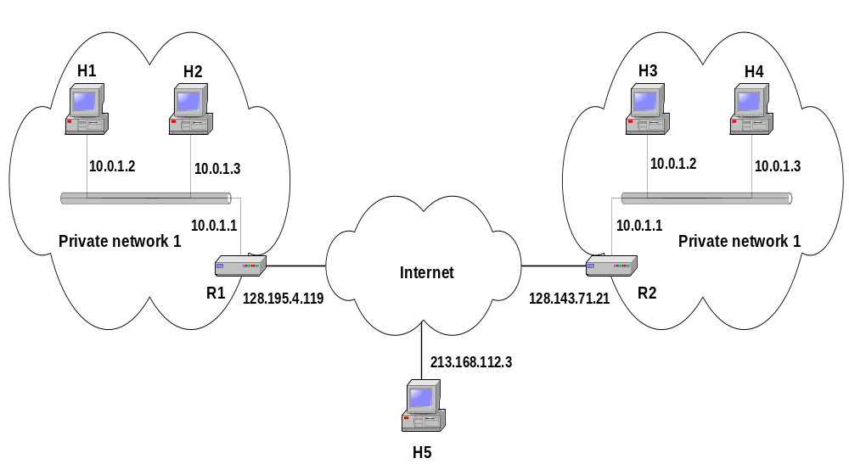
Private Addresses

Slide 4
Network Address Translation (NAT)
RFC 1631
A short term solution to the problem of the depletion of IP addresses
  Long term solution is IPv6
  CIDR (Classless InterDomain Routing ) is a possible short term solution
  NAT is another
NAT is a way to conserve IP addresses
  Can be used to hide a number of hosts behind a single IP address
  Uses private addresses:
    10.0.0.0-10.255.255.255,
    172.16.0.0-172.32.255.255 or
    192.168.0.0-192.168.255.255

Slide 5
Network Address Translation (NAT)
NAT is a router function where IP addresses (and possibly port numbers) of IP datagrams are replaced at the boundary of a private network
NAT is a method that enables hosts on private networks to communicate with hosts on the Internet
NAT is run on routers that connect private networks to the public Internet, to replace the IP address-port pair of an IP packet with another IP address-port pair.

Slide 6
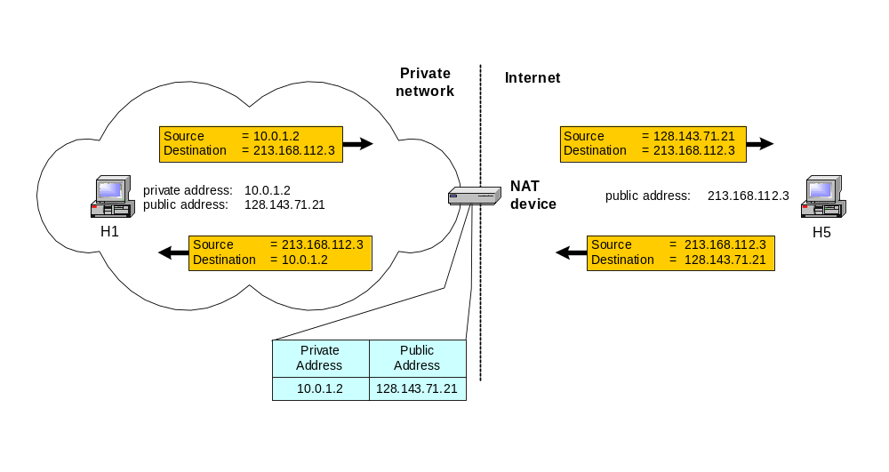
Basic Operation of NAT
NAT device has address translation table
One to one address translation

Slide 7
Pooling of IP Addresses
Scenario: Corporate network has many hosts but only a small number of public IP addresses
NAT solution:
  Corporate network is managed with a private address space
  NAT device, located at the boundary between the corporate network and the public Internet, manages a pool of public IP addresses
  When a host from the corporate network sends an IP datagram to a host in the public Internet, the NAT device picks a public IP address from the address pool, and binds this address to the private address of the host

Slide 8
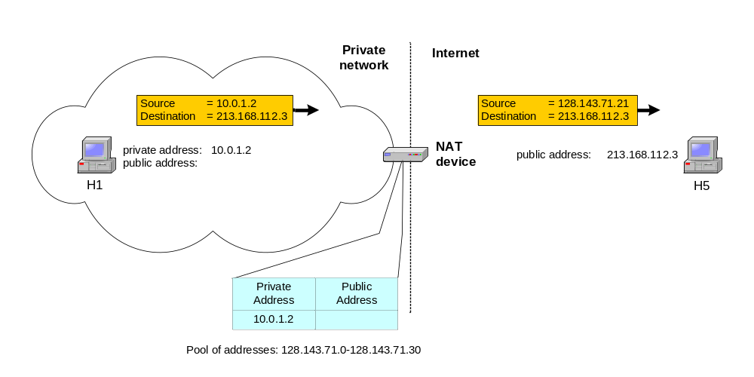
Pooling of IP Addresses

Slide 9
Supporting Migration between Network Service Providers
Scenario: In CIDR, the IP addresses in a corporate network are obtained from the service provider. Changing the service provider requires changing all IP addresses in the network.
NAT solution:
  Assign private addresses to the hosts of the corporate network
  NAT device has static address translation entries which bind the private address of a host to the public address.
  Migration to a new network service provider merely requires an update of the NAT device. The migration is not noticeable to the hosts on the network.
  Note:
  The difference to the use of NAT with IP address pooling is that the mapping of public and private IP addresses is static.

Slide 10
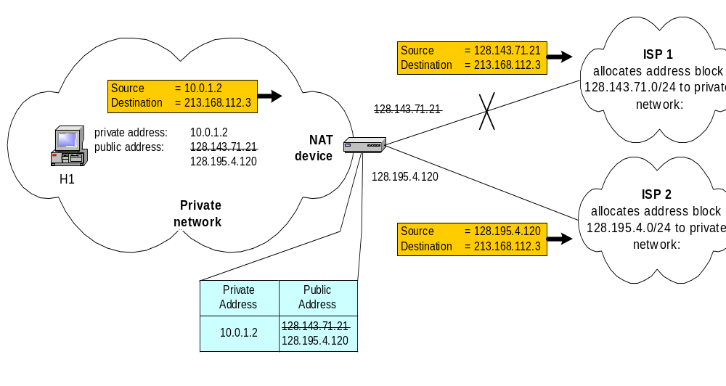
Supporting Migration between network service Providers

Slide 11
IP Masquerading
Also called: Network address and port translation (NAPT), port address translation (PAT).
Scenario: Single public IP address is mapped to multiple hosts in a private network.
NAT solution:
  Assign private addresses to the hosts of the corporate network
  NAT device modifies the port numbers for outgoing traffic

Slide 12
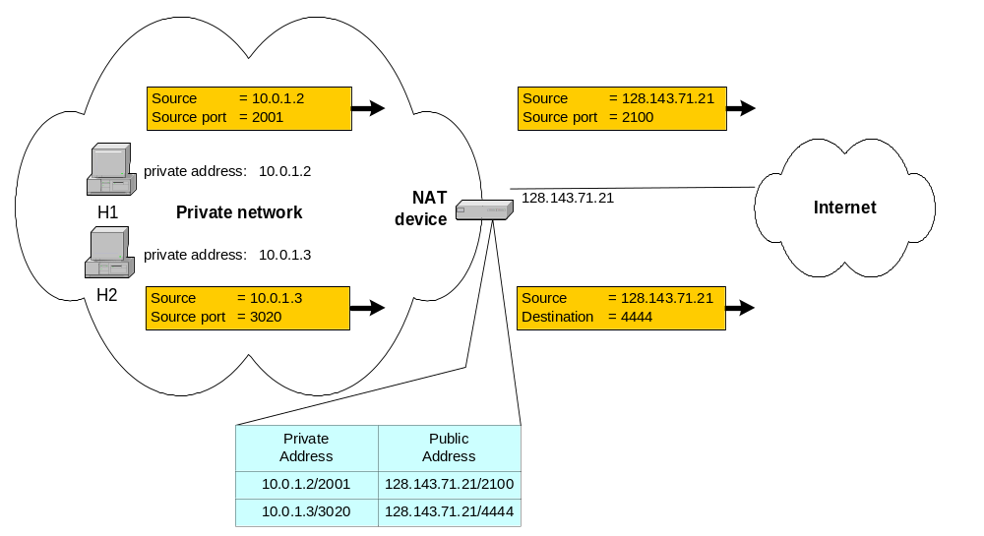
IP Masquerading

Slide 13
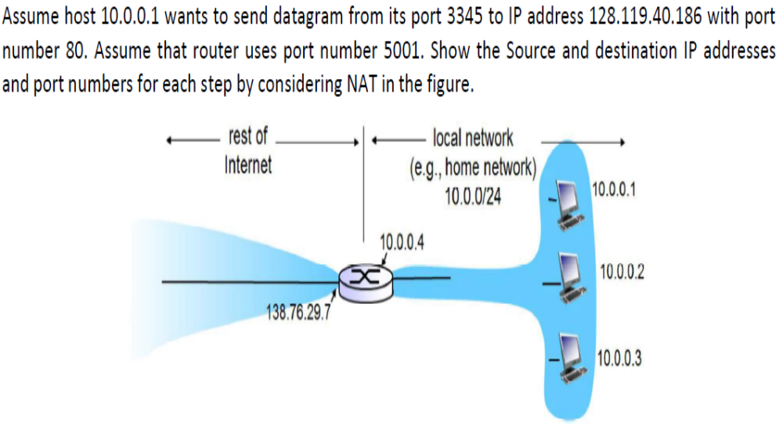

Slide 14
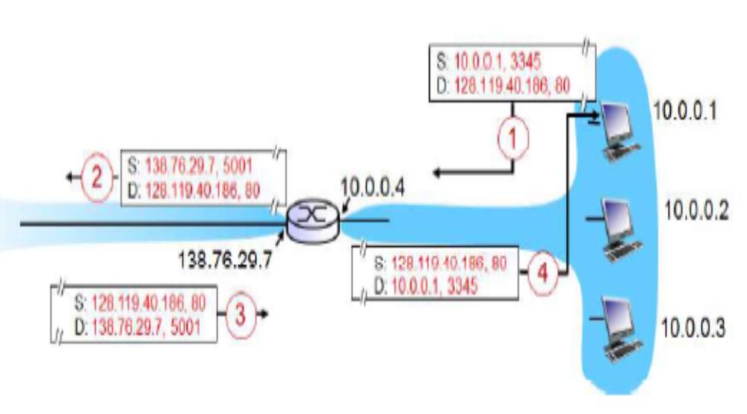

Slide 15
Load Balancing of Servers
Scenario: Balance the load on a set of identical servers, which are accessible from a single IP address
NAT solution:
  Here, the servers are assigned private addresses
  NAT device acts as a proxy for requests to the server from the public network
  The NAT device changes the destination IP address of arriving packets to one of the private addresses for a server
  A sensible strategy for balancing the load of the servers is to assign the addresses of the servers in a round-robin fashion.

Slide 16
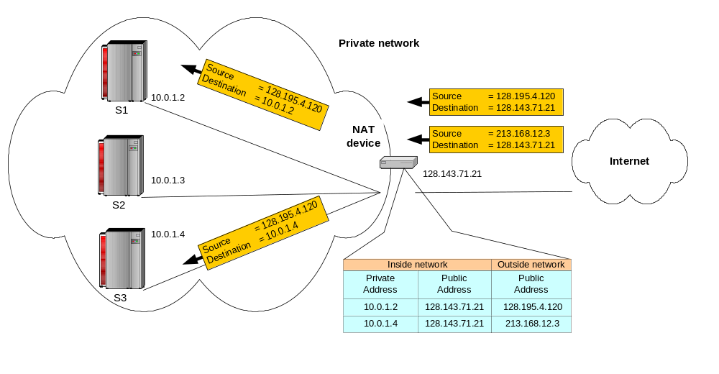
Load Balancing of Servers

Slide 17
Concerns about NAT
Performance:
  Modifying the IP header by changing the IP address requires that NAT boxes recalculate the IP header checksum
  Modifying port number requires that NAT boxes recalculate TCP checksum
Fragmentation
  Care must be taken that a datagram that is fragmented before it reaches the NAT device, is not assigned a different IP address or different port numbers for each of the fragments.

Slide 18
Concerns about NAT
End-to-end connectivity:
  NAT destroys universal end-to-end reachability of hosts on the Internet.
  A host in the public Internet often cannot initiate communication to a host in a private network.
  The problem is worse, when two hosts that are in a private network need to communicate with each other.

Slide 19
Concerns about NAT
IP address in application data:
  Applications that carry IP addresses in the payload of the application data generally do not work across a private-public network boundary.
  Some NAT devices inspect the payload of widely used application layer protocols and, if an IP address is detected in the application-layer header or the application payload, translate the address according to the address translation table.

Slide 20
Brief Overview of FTP
RFC 959
Uses two TCP Ports
  One for control
  One for data transfers
Command-response protocol
Control port uses telnet protocol to negotiate session
  US-ASCII
  <crlf> is end-of-line character

Slide 21
Active Mode FTP
Client connect from a random unprivileged port (n > 1023) to the servers command port (21) and sends port command to tell server to connect to n+1 then listens on the next higher unprivileged port (n+1) for server responses. The server connects from it’s data port (20) to the client data port (n+1).
Server
Client
20
21
1026
1027
1
2
3
4

Slide 22
Passive Mode FTP
Client opens two random unprivileged ports ( n > 1023 and n+1; for example 1026 and 1027) and connects the first port (n) to server command port 21 and issues a pasv command (server sends port to use for data); client connects to servers specified data port, server completes connection.
Server
Client
20
2024
21
1026
1027
1
2
3
4

Slide 23
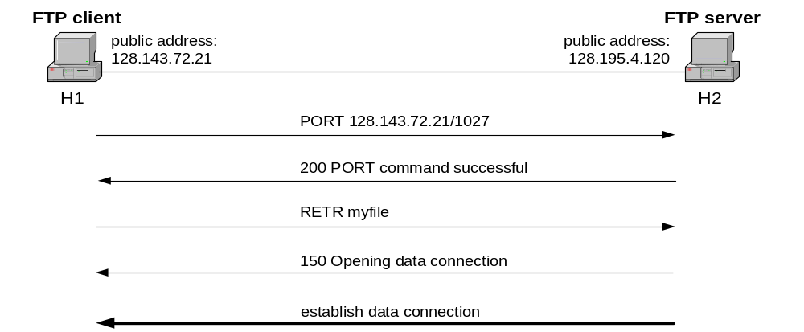
NAT and FTP
Normal FTP operation

Slide 24
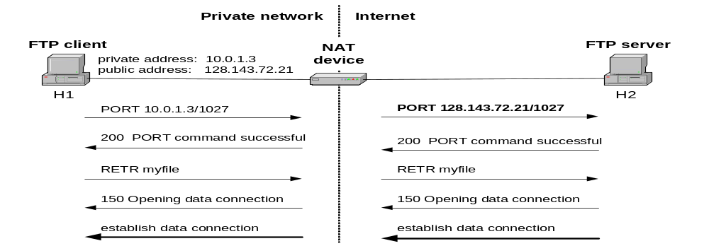
NAT and FTP
NAT device with FTP support

Slide 25
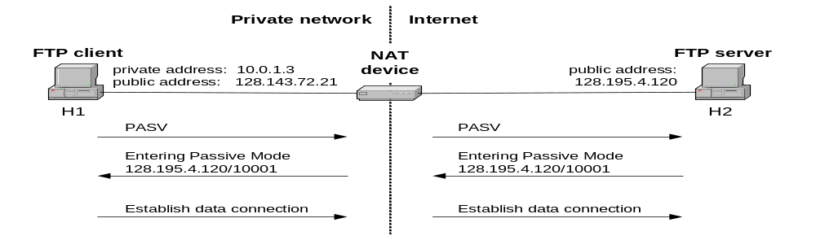
NAT and FTP
FTP in passive mode and NAT.

Slide 26
NAT Supported Traffic Types
Traffic Types/Applications Supported
Traffic Types/Applications not Supported
Any TCP/UDP Traffic that Does Not Carry Source and/or Destination IP Addresses in the Application Data Stream
IP Multicast
HTTP
Routing Table Updates
TFTP
DNS Zone Transfers
Telnet
BOOTP
archie
Talk, Ntalk
finger
H.323
NTP
VDOLive
NFS
NetShow
rlogin, rsh, rcp
VXtreme
Although the Following Traffic Types Carry IP
Addresses in the Application Data Stream, they
are Supported by Cisco IOS NAT:
SNMP
ICMP
SMTP
FTP (Including PORT and PASV Commands)
NetBIOS over TCP/IP
Progressive Networks?RealAudio
White Pines CuSeeMe
DNS "A" and "PTR" Queries
Xing Technologies StreamWorks

Slide 27
Firewall Programs
Ipfwadm : Linux kernel 2.0.34
Ipchains : Linux kernel 2.2.*
Iptables : Linux kernel 2.4.*

Slide 28
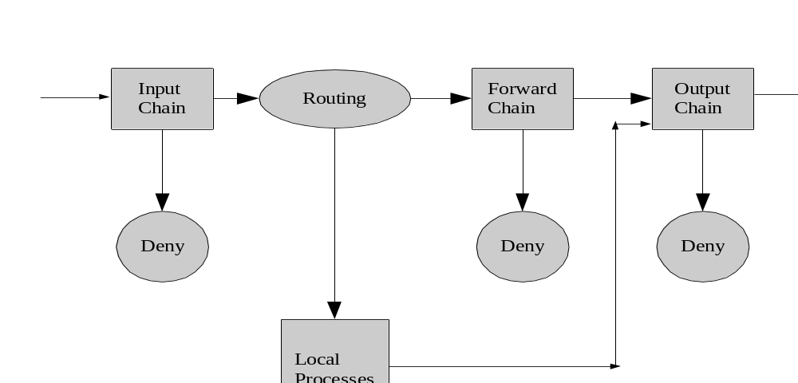
Ipchains Packet Traversal

Slide 29
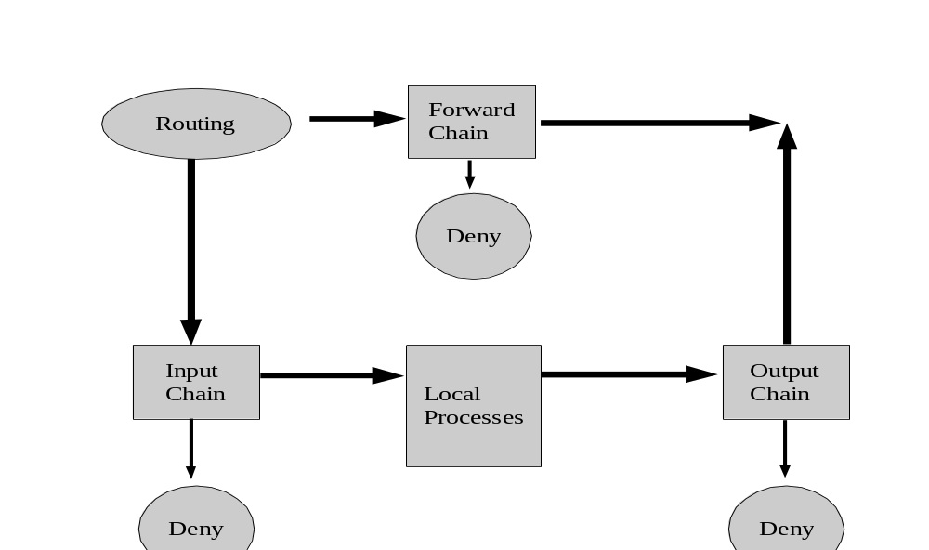
Iptables Packet Traversal

Slide 30
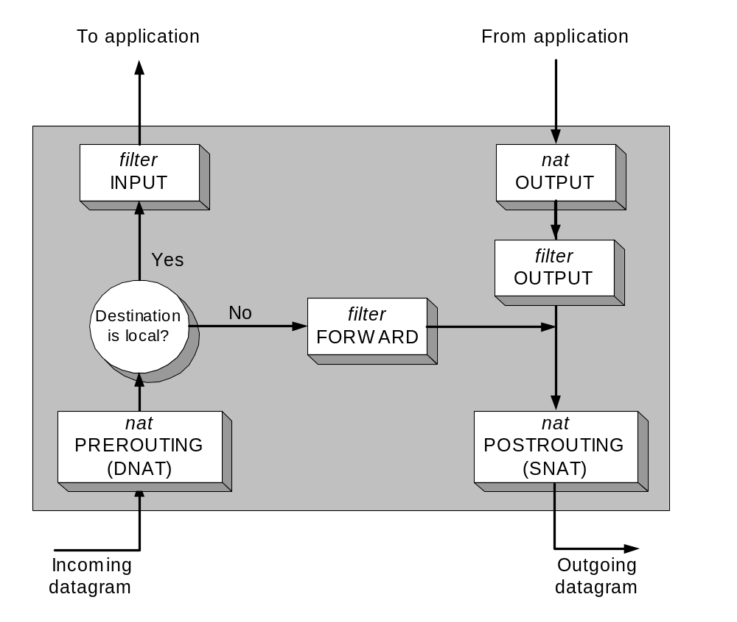
Configuring NAT in Linux
Linux uses the Netfilter/iptable package to add filtering rules to the IP module

Slide 31
Iptables NAT Overview
Source NAT
  The source address of the initial packet is modified.
  Performed on the POSTROUTING Chain.
  Includes MASQUERADE functionality.
Destination NAT
  The destination address of the initial packet is modified.
  Performed on the PREROUTING or OUTPUT chain.

Slide 32
Configuring NAT with iptables
First example:
iptables –t nat –A POSTROUTING –s 10.0.1.2
–j SNAT --to-source 128.143.71.21
Pooling of IP addresses:
iptables –t nat –A POSTROUTING –s 10.0.1.0/24
–j SNAT --to-source 128.128.71.0–128.143.71.30
ISP migration:
iptables –t nat –R POSTROUTING –s 10.0.1.0/24
–j SNAT --to-source 128.195.4.0–128.195.4.254
IP masquerading:
iptables –t nat –A POSTROUTING –s 10.0.1.0/24
–o eth1 –j MASQUERADE
Load balancing:
iptables -t nat -A PREROUTING -i eth1 -j DNAT --to-destination 10.0.1.2-10.0.1.4

Slide 33
NAT Summary
NAT provides transparent and bi-directional connectivity between networks having arbitrary addressing schemes
NAT eliminates costs associated with host renumbering
NAT conserves IP addresses
NAT eases IP address management
NAT enhances network privacy

Slide 34
NAT Limitations
Applications with IP-address content
  Need AGL (Application Level Gateway)
Applications with inter-dependent control and and data sessions
Translation of fragmented FTP control packets

Slide 35
Extra: Hacking through NAT
Static Translation
  offers no protection of internal hosts
Internal Host Seduction
  internals go to the hacker
    e-mail attachments – Trojan Horse virus’
    peer-to-peer connections
    hacker run porn and gambling sites
  solution = application level proxies
State Table Timeout Problem
  hacker could hijack a stale connection before it is timed out
  very low probability but smart hacker could do it
Source Routing through NAT
  if the hacker knows an internal address they can source route a packet to that host
    solution is to not allow source routed packets through the firewall

